Slide 1



LESSON PLAN
WWW.DAYFORDREAMERS.COM
#WorldDreamDay @dayfordreamers

Slide 2
SHARE YOUR DREAM.
START A MOVEMENT.
CHANGE THE WORLD.
@DAYFORDREAMERS WWW.DAYFORDREAMERS.COM #WORLDDREAMDAY

Slide 3
THE DREAM LESSON PLAN
WWW.DAYFORDREAMERS.COM
Learning Goals | Identify the role and importance that dreaming plays in the world around us Explore a specific dream that you have Determine how achieving this Dream/Goal will affect your world (Personal, Local, Global) Declare Your Dream by completing a Dream Declaration Certificate Commit to supporting yourself and others in achieving their Dreams
Common Core Standards | Comprehension and Collaboration Engage effectively in a range of collaborative discussions (one-on-one, in groups, and teacher-led) with diverse partners on grade level topics, texts, and issues, building on others' ideas and expressing their own clearly. Follow rules for collegial discussions, set specific goals and deadlines, and define individual roles as needed.
Warm-Up (5-8Mins.) | Option1: Ask students to name an invention or person that has greatly influenced the world in which we currently live? Chart student responses. Option 2: On Index cards write the names of major known inventions and leaders/public figures. Have students blindly pick cards. Have Students popcorn share what is written on their index card and how this person or item has affected the world. Chart responses. Option 3: Ask Students to name something that doesn’t currently exist in their lives/world that they wish did? Chart student responses.
Mini-Lesson (8-10Mins.) | The World Of Dreams Power Point Presentations (Provided) Focus Questions: 1) What is a Dream? 2) To whom does a Dream belong? 3) What are the ‘steps’ of Dreaming? 4) What is your Dream?
WORLD DREAM DAY SUGGESTED LESSON PLAN [EST. TIME 1 HR]

Slide 4
THE DREAM LESSON PLAN
WWW.DAYFORDREAMERS.COM
Activity (25-30 Mins.) | Creative visualization: Using question #5 as a starting point, students will be asked to visualize their dream. What does it look like? How will the world/their world be different once their dream is activated? Students will transfer what they envisioned onto their Dream Document worksheet. Dream Strategy: Students are broken up into pairs and take turns sharing Dream Document Worksheet (Provided)with partners. Partners then provide support and suggestive feedback on action steps.3-4. (Check in) Call on 1-2 Students to share their dreams while group supports them by exploring barriers and opportunities to achieving the dream. Dream Declaration: Students complete Dream Declaration Certificate (Provided) that specifies their Dream and 3 Actions that they will take towards its achievement. (Check In) Call on 2-4 students to share their Dream Declarations and Action steps.
Debrief and Follow-up (8-10mins) | Give students the opportunity to discuss and class share their answers to the following questions: What did you learn about yourself through this activity? What did you learn about your classmate? How do you envision your Dream Declaration helping you achieve your Dream? Encourage further exploration by telling them about apprenticeships, community organizations, websites or other things that can help them learn more. ( Suggested list provided) (Optional) Photo copy student completed Dream Document Worksheet and Dream Declarations, return the originals and keep a copy for Dream Portfolio. This portfolio can be used to provide additional support and accountability for students.
Materials | School: Markers, Index cards, Chart Paper, Pens/Pencils, Notebooks/Journals Downloadable Documents: Power Point Presentation, Guided Visualization audio/video, Dream Document worksheet, Dream Declarations, Dream Runner Commitment Pledge cards.
WORLD DREAM DAY SUGGESTED LESSON PLAN [EST. TIME 1 HR]

Slide 5

THE DREAM MANIFESTO
THE WORLD BELONGS TO THOSE WHO DARE TO BELIEVE
IN THE POWER, BEAUTY AND BRILLIANCE OF THEIR DREAMS.
THOSE WHO DARE TO MEND A WORLD UNRAVELING AT ITS SEAMS.
THE WORLD BELONGS TO THE DREAMER AND DOER THAT LIVES WITHIN YOU AND ME.
WE BUILD A BETTER FUTURE WHEN WE ARE WILLING TO LET OUR BEST IDEAS ROAM FREE.
TODAY, THE WORLD IS CALLING UPON US TO ACTIVATE OUR POWER TO DREAM DIFFERENTLY.
SO LET’S JOIN TOGETHER AND BUILD
BETTER LIVES, BETTER BUSINESSES AND BETTER COMMUNITIES.
LET’S DREAM UP A BETTER, BRIGHTER WORLD
FILLED WITH ENDLESS POSSIBILITIES.
LET’S DREAM UP A MORE LOVING, WHOLE AND PEACEFUL HUMAN FAMILY.
WWW.DAYFORDREAMERS.COM
#WorldDreamDay @dayfordreamers

Slide 6
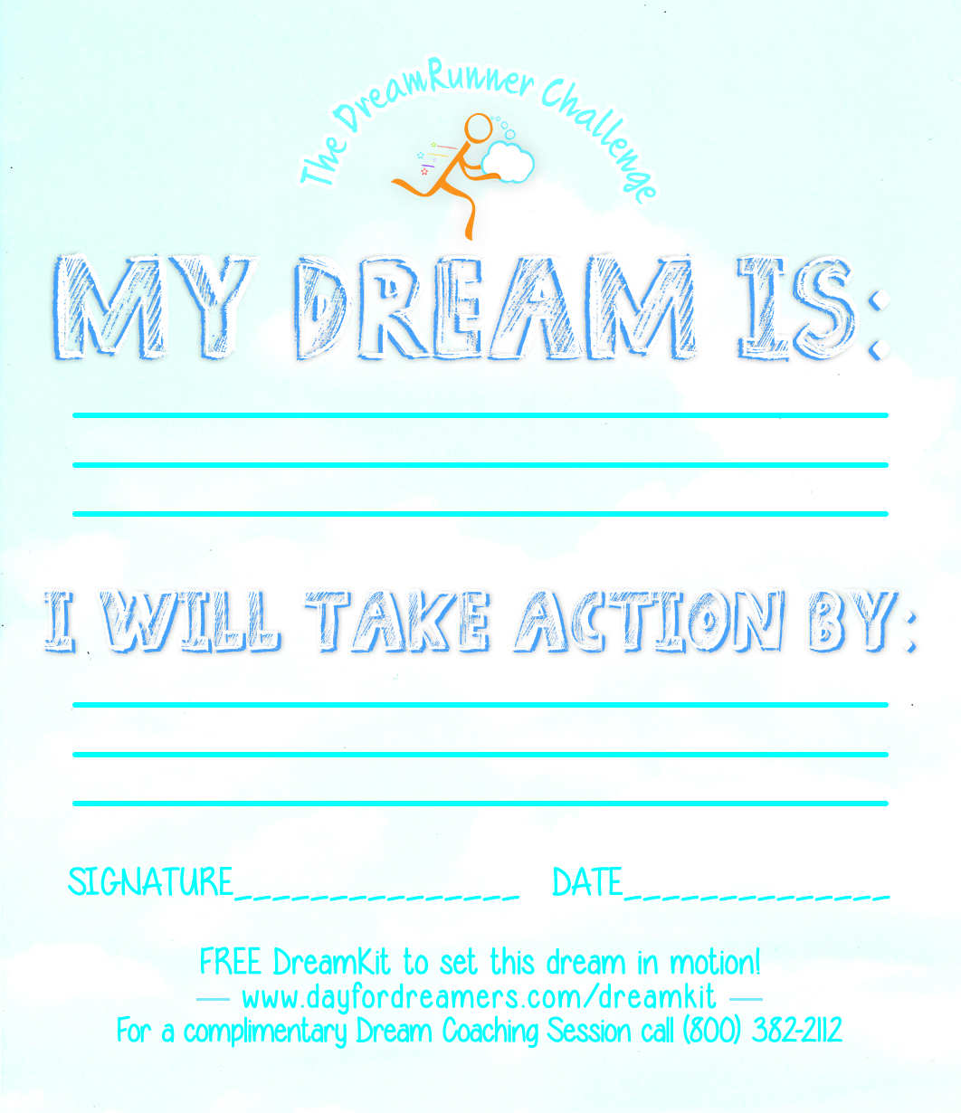
THE DREAM CARD
PRINT OUT DREAM CARD. THE CARD IS DOUBLE-SIDED. FOLD IT IN HALF. DISTRIBUTE TO STUDENTS. INVITE THEM TO DREAM BIG & TAKE ACTION!

